Slide 1


Today’s Agenda
Motivation and background
Stability of a Portfolio
Sharpe optimized stable Portfolios
Maximum Drawdown Optimized stable Portfolios
Market Health Index
MHI based MDD optimized stable Portfolios

Slide 2

Asset Allocation Strategies
Defining asset classes
Strategic vs. tactical asset allocation
Factors influencing asset allocation decisions
Implementing an effective asset allocation model
Photo by: Steve Johnson https://www.pexels.com/@steve

Slide 3
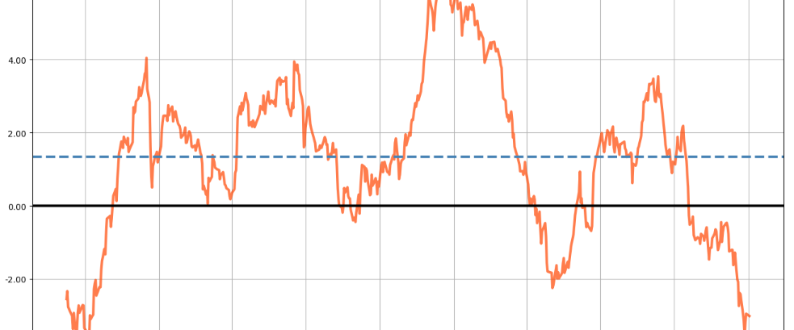
MHI Portfolios

Slide 4
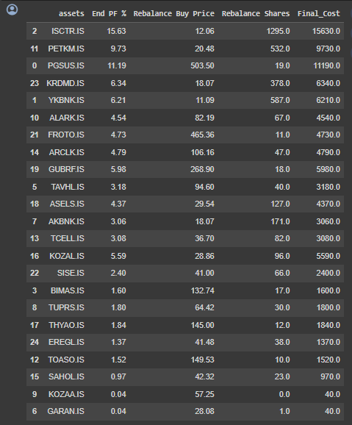
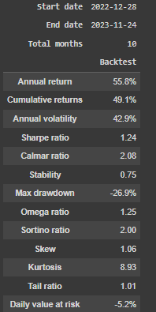
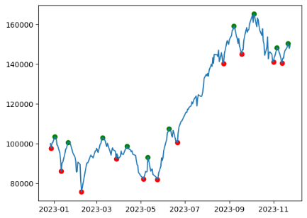
An optimized portfolio for 28.12.2022 – 24.12.2023

Slide 5
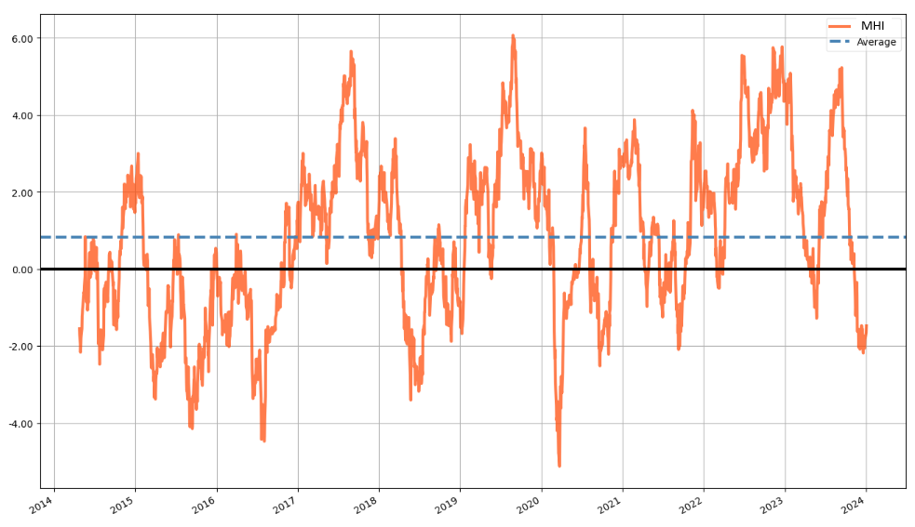
Market Health Index (MHI) - A mean-reverting index for trend detection

Slide 6
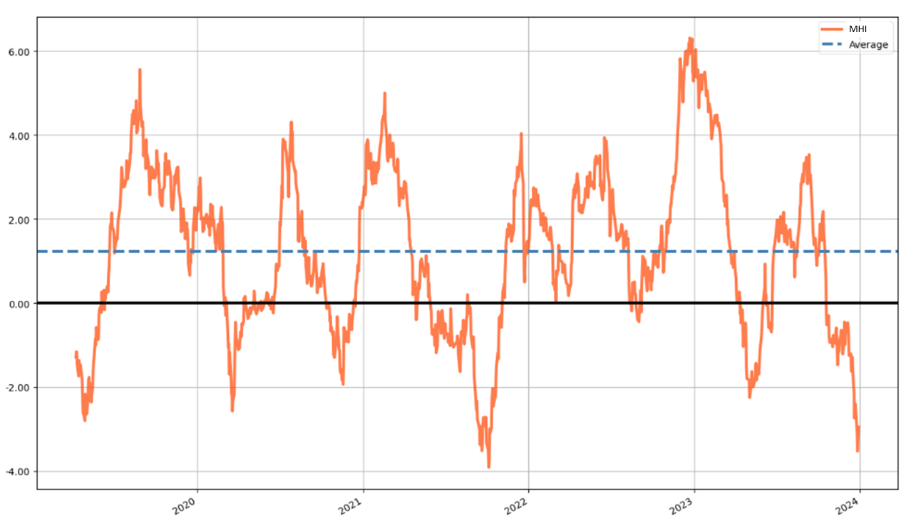
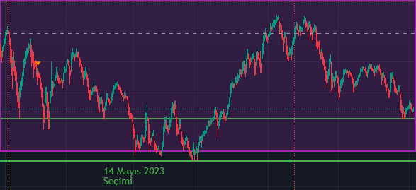
Market Health Index (MHI) - A mean-reverting index for trend detection
MHI on BIST30
Downtrend Uptrend
PREV UPTREND
23.08.2021 – 21.09.2022 21.09.2021 – 16.12.2021 (I)
16.12.2021 – 24.02.2022 24.02.2022 – 07.06.2022 (II)
07.06.2022 – 16.08.2022 16.08.2022 – 27.12.2022 (III)
27.12.2022 – 09.05.2023 09.05.2023 – 11.09.2023 (IV)
11.09.2023 – 26.11.2023 NEXT UPTREND
BIST100 – last 1 year
Last 5 years >>

Slide 7
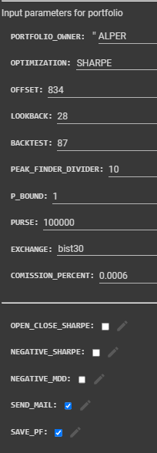
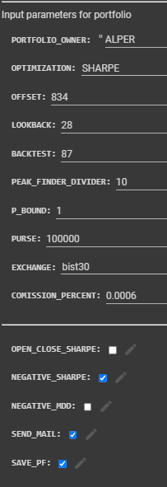
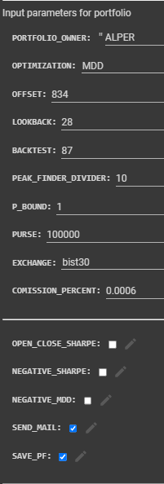
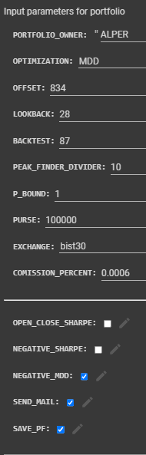
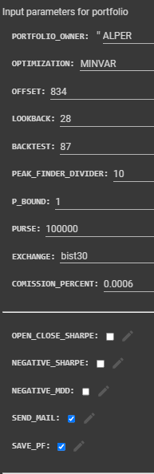
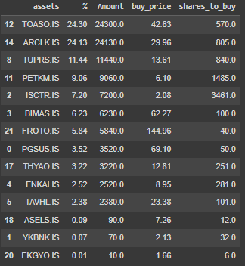

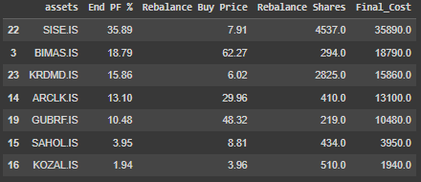

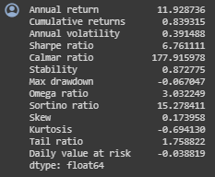
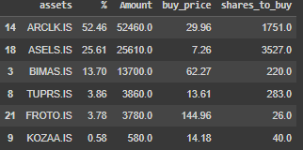
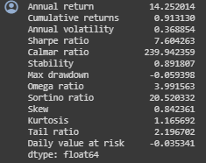
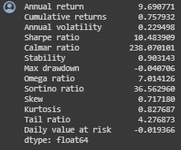
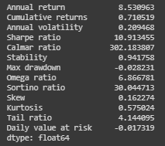
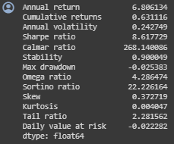
MHI portfolios for 21.09.2021 – 16.12.2021 (I)
Sharpe i-Sharpe MDD i-MDD MINVAR
Return: %91.3
SR: 7.6
MDD: %5.93
Return: %83.9
SR: 6.76
MDD: %6.7
Return: %75.8
SR: 10.48
MDD: %4
Return: %63.1
SR: 8.61
MDD: %2.53
Return: %71.1
SR: 10.91
MDD: %2.82

Slide 8
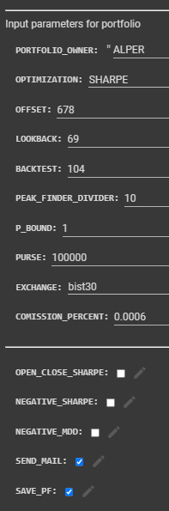
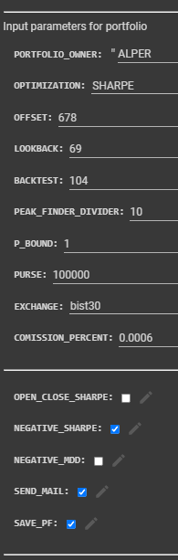
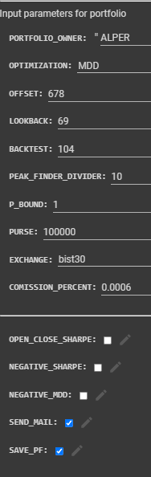
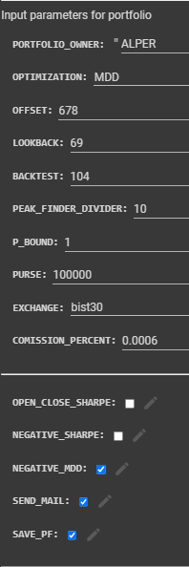
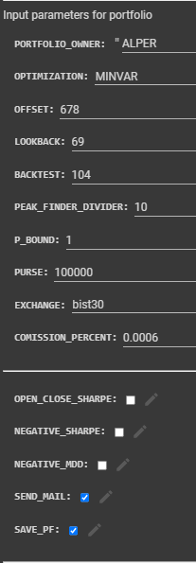

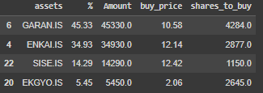


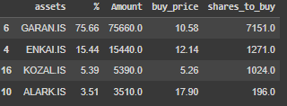
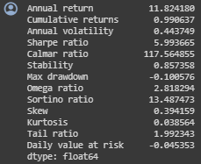
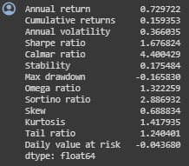
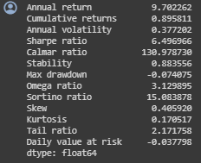
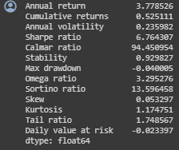
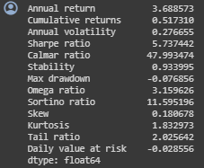
MHI portfolios for 24.02.2022 – 07.06.2022 (II)
Sharpe i-Sharpe MDD i-MDD MINVAR
Return: %99
SR: 5.99
MDD: %10.0
Return: %15.93
SR: 1.67
MDD: %16.58
Return: %89.6
SR: 6.49
MDD: %7.40
Return: %52.5
SR: 6.76
MDD: %4.0
Return: %51.7
SR: 5.73
MDD: %7.68

Slide 9
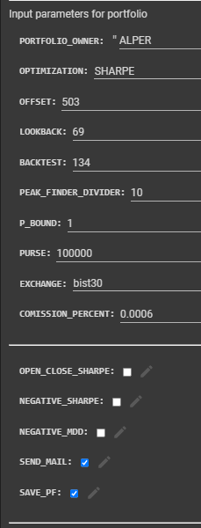
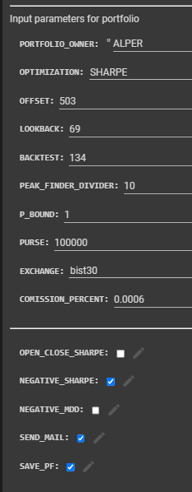
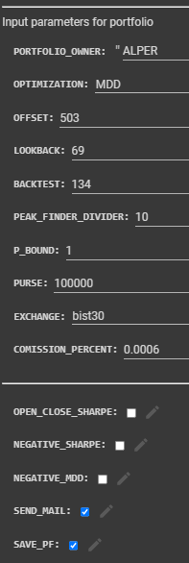
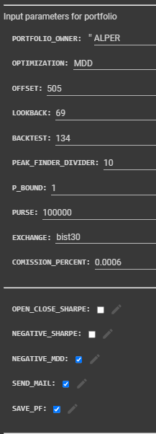
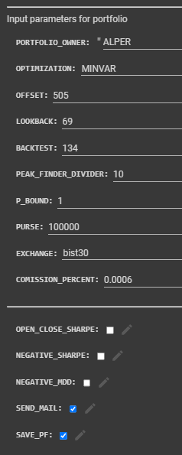
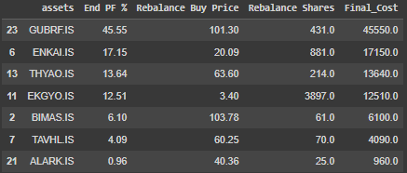
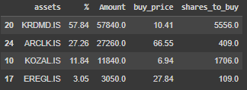
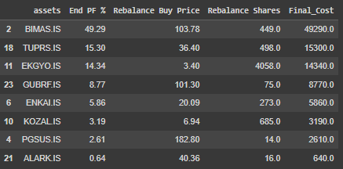

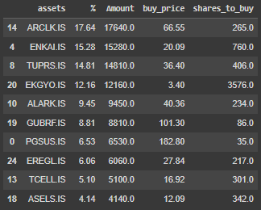
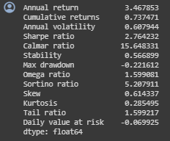
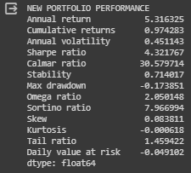
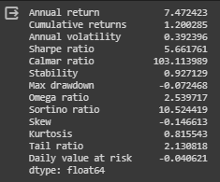
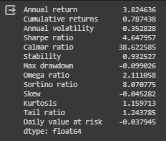
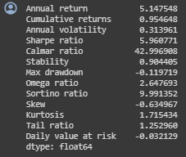
MHI portfolios for 16.08.2022 – 27.12.2022 (III)
Sharpe i-Sharpe MDD i-MDD MINVAR
Return: %73.7
SR: 2.76
MDD: %22.2
Return: %120
SR: 5.66
MDD: %7.2
Return: %97.4
SR: 4.32
MDD: %17.4
Return: %78.7
SR: 4.64
MDD: %9.9
Return: %95.5
SR: 5.96
MDD: %12.0

Slide 10
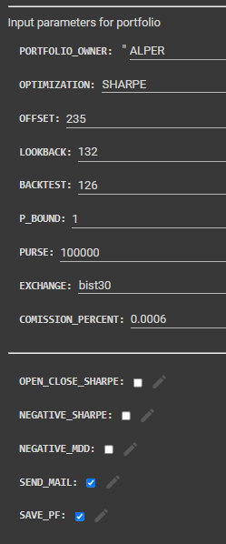
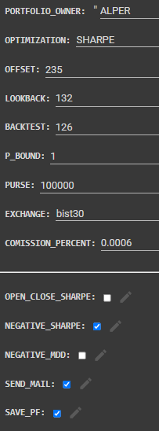
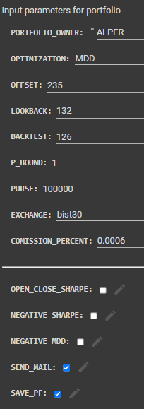
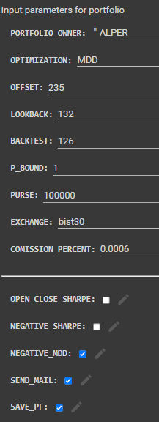











MHI portfolios for 09.05.2023 – 11.09.2023 (IV)
Sharpe i-Sharpe MDD i-MDD MINVAR
Return: %56.6
SR: 2.75
MDD: %13.7
Return: %65.6
SR: 3.39
MDD: %11.4
Return: %80.4
SR: 3.96
MDD: %16.1
Return: %64.3
SR: 3.96
MDD: %17.8
Return: %92.3
SR: 4.82
MDD: %12.4

Slide 11




Slide 12
Procedure for Portfolio Construction
Calculate and plot 5 year-MHI
Detect peaks (MHI > 4) and valleys (MHI < -2)
Apply Correlation filter
At the valleys, starting from latest peak calculate portfolio and enter that portfolio.
At the first peak, sell the portfolio.

Slide 13

Filter for Correlation

Slide 14

Filter for Volatility

Slide 15

Our B2B Product: AI optimized MHI Portfolios
AI assisted portfolio generation in Python with:
Entry exit based on MHI – mean reverting Market Health Index
Sharpe, i-Sharpe, MDD, i-MDD, MinVAR optimized
Correlation, volatility, fundamentals filter
To be added: KAP news filter
Consolidated returns
Customer Positioning:
Retail long-portfolio traders
Insurance banks
Retirees
QUESTIONS ?

